Slide 1

Train network manager
Algorithms Project 22/23

Slide 2
Problem Description
This project aims to develop a program that can analyze data related to the national train network. The program will be able to identify various parameters such as the maximum number of trains that can reach a station, the maximum number of trains that can travel between two stations, and the maximization of revenue, to name a few

Slide 3
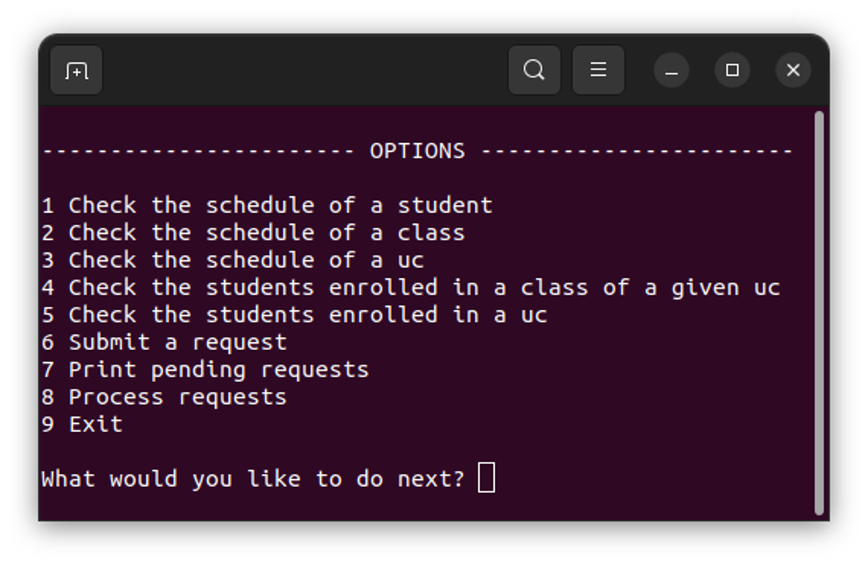
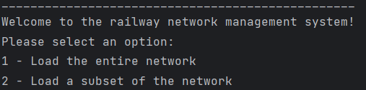
Implemented features
Reading the data
The methods loadWithoutFilters and loadWithFilters are used to read the provided data using two functions:
readStations() - reads the stations.csv file, creates objects of the Station class from the data, and adds a new node to the graph for each station. Auxiliary maps are also created.
readNetwork() - reads the network.csv file and adds to the graph the edges that represent connections between two stations. For each connection, an edge is added in each direction, with the capacity specified in the file.
Using the loadWithFilters method, it is possible to load only a portion of the network by specifying which lines or stations are desired.
As you can see on the right, we can load a subset of the network.

Slide 4
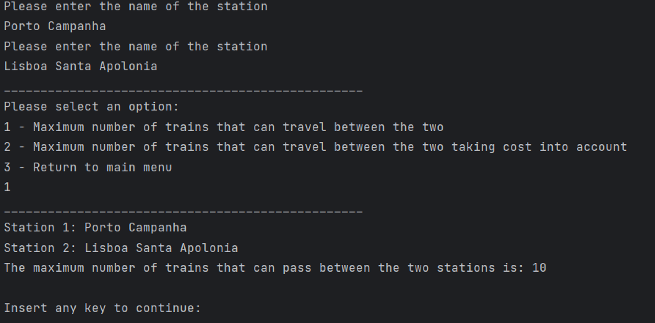
Implemented features
Max number of trains between two stations
For this feature, we use the Edmonds-Karp algorithm to calculate the maximum flux between the two.

Slide 5
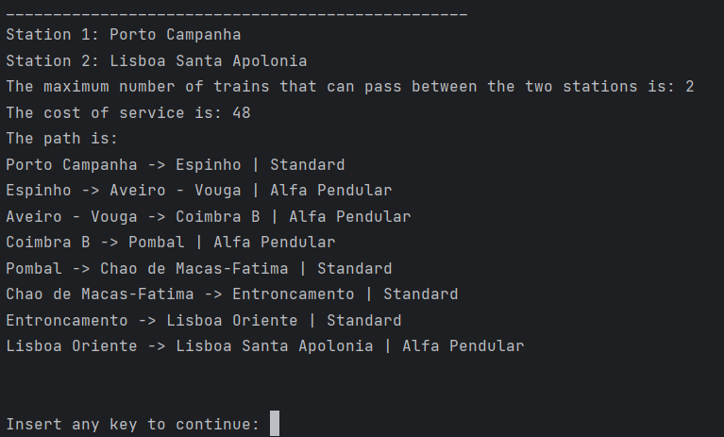
Implemented features
Max number of trains between two stations taking cost into account
For this feature, we first calculate the min-cost path using Dijkstra(this takes into account the cost of service and the number of trains). Then, we calculate the bottleneck capacity.

Slide 6
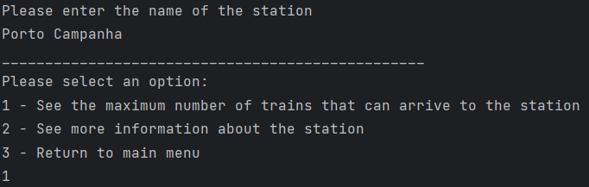
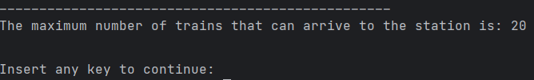
Implemented features
Max number of trains reaching a station
For this feature, a super source is created, connected to all stations that have only one connection to another station (which we interpreted as terminals). Then we use Edmonds-Karp to calculate the maximum flow from the super source to the station we are studying

Slide 7
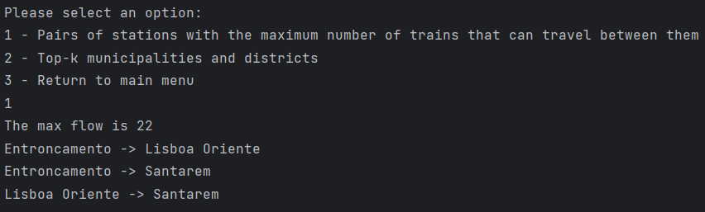
Implemented features
Which stations require more trains
For this feature, we iterate over every pair of stations and calculate the flow. Then we display the stations with the max flow as you can see below.

Slide 8
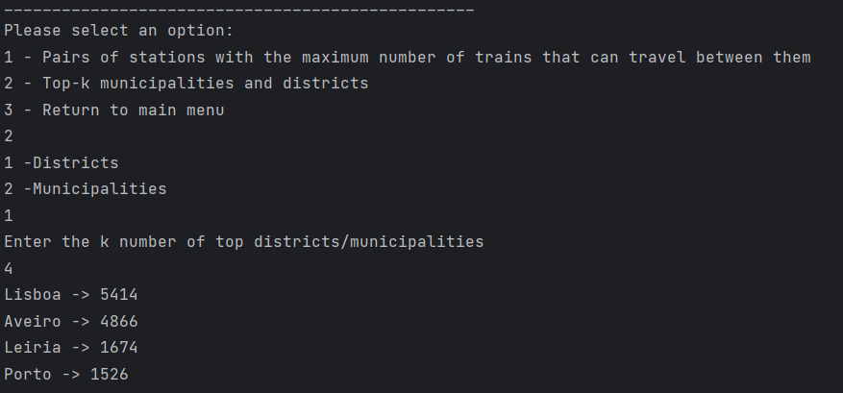
Implemented features
Top-k districts and municipalities
This feature ranks districts/municipalities based on the total flow of all pairs of stations within each district/municipality. The user can select the number 'k' of districts/municipalities they want to view as you can see below.

Slide 9
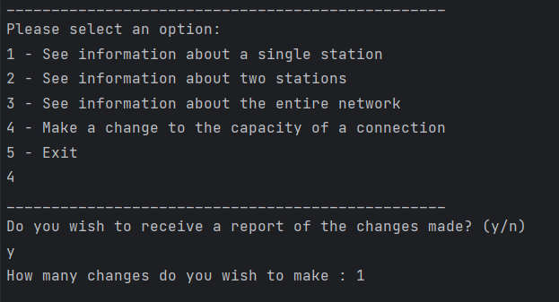
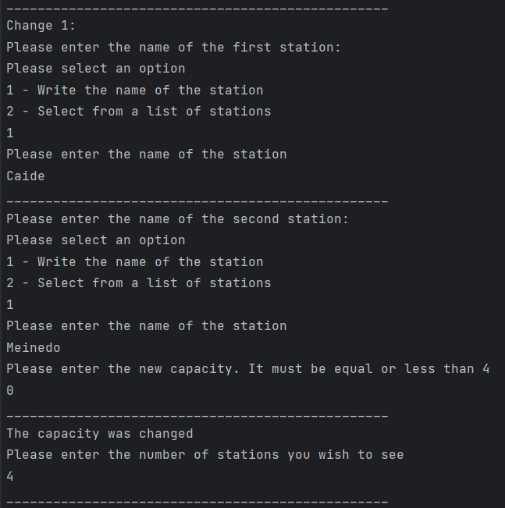
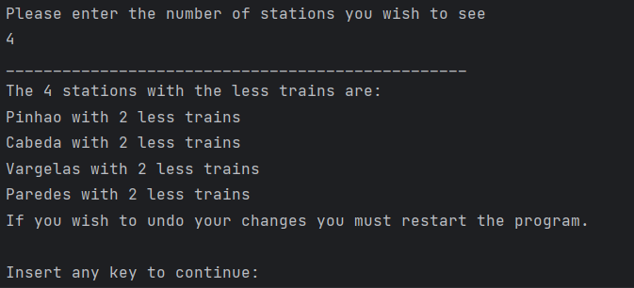
Implemented features
Network with reduced connectivity
We start by asking the user if he wants to receive a report. If he does, we calculate the max number of trains that can enter the station before the change and after. We then show the stations where the change was greater.

Slide 10
Group Members
Grupo G14_1
Adriano Machado – 202105352
José Pedro Evans – 202108818
Rodrigo Moisés Ribeiro – 202108679

